Slide 1



OpenFeign
The declarative web service client

Slide 2
Agenda
What is Feign
Why Feign
Demo
How we use it in Resttest

Slide 3
What is Feign
Opensource - https://github.com/OpenFeign/feign
API Consumer
REST
SOAP
Declarative programming
Annotations
Java configuration
.yml configuration

Slide 4
Why Feign
Hystrix is on the classpath and feign.hystrix.enabled=true
Fast to integrate
Easy to work with / configure / maintain
Eureka discovery client integration - spring-cloud-starter-netflix-eureka-client
Ribbon is client side load balancer - spring-cloud-starter-netflix-ribbon
Circuit breaker pattern - feign.hystrix.enabled=true
Spring MVC annotations

Slide 5
Demo
Eureka Server
Spring Boot Rest Application – with multiple instances
Spring Boot Feign Client Application

Slide 6
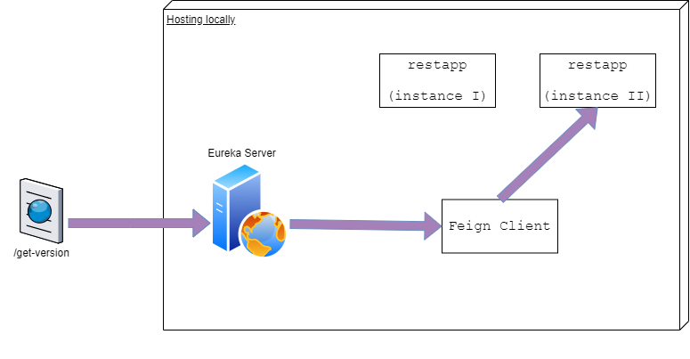
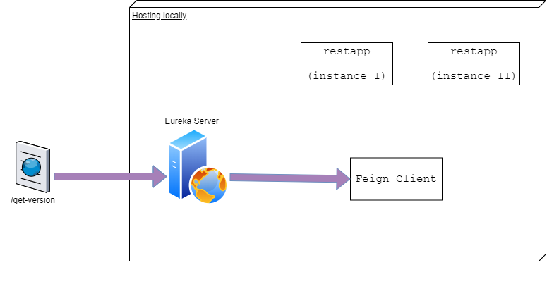
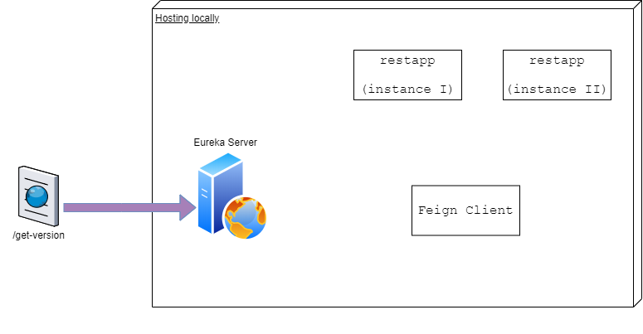
Demo
/get-version

Slide 7
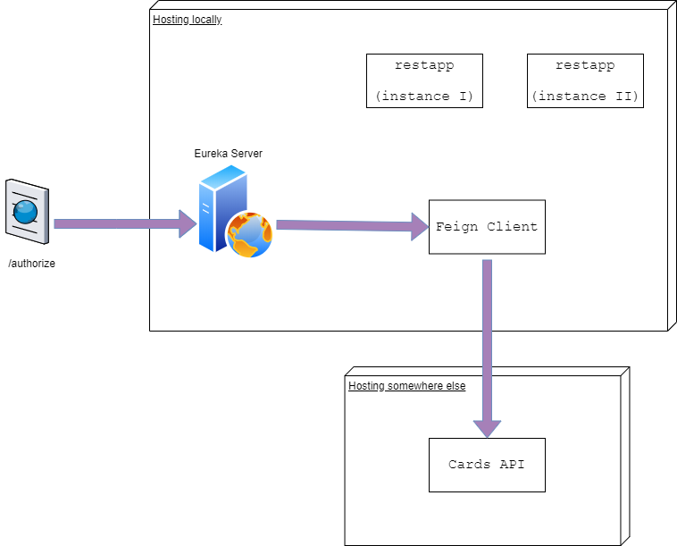

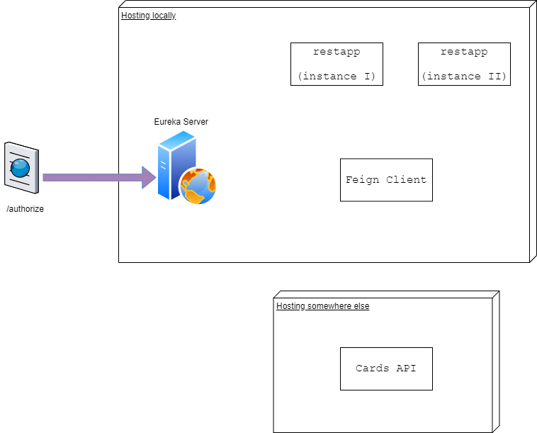
Demo
/authorize

Slide 8
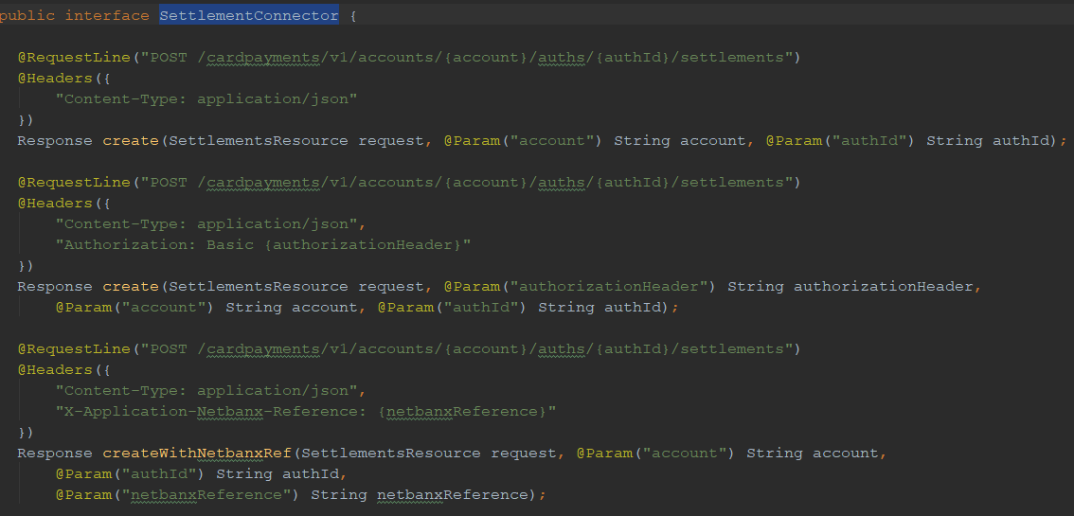
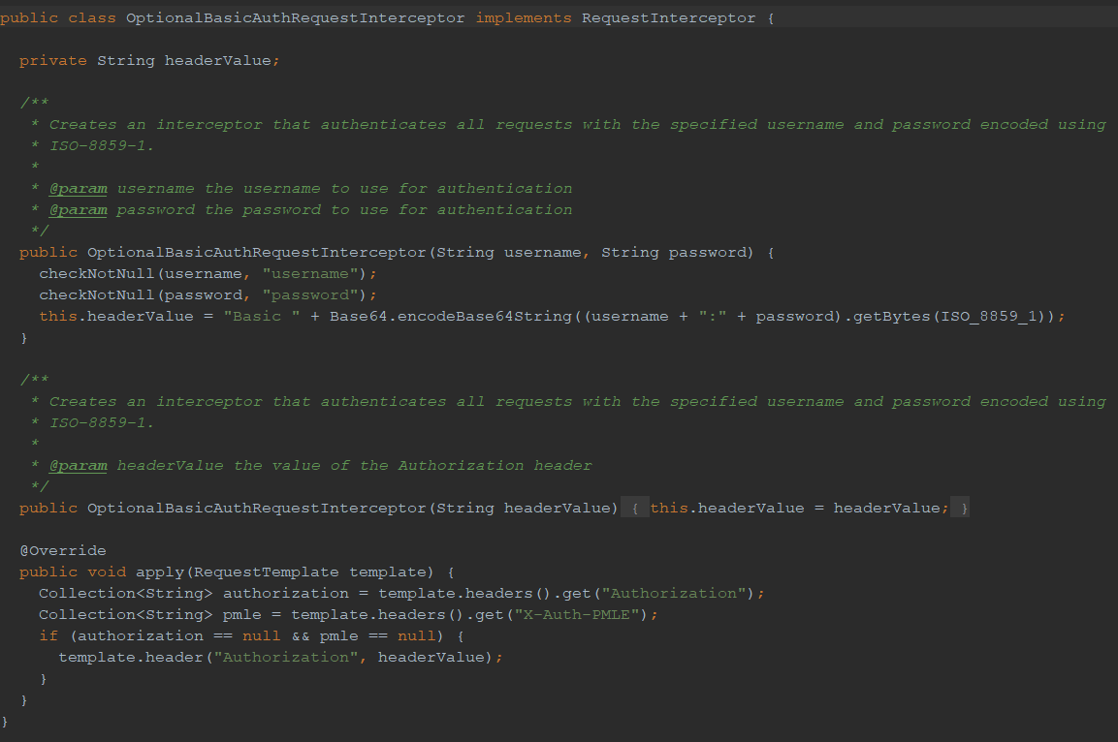
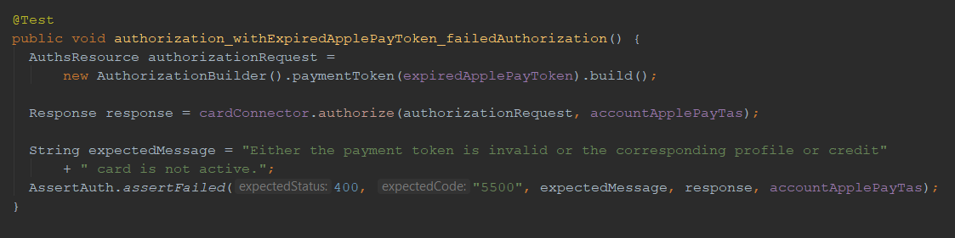
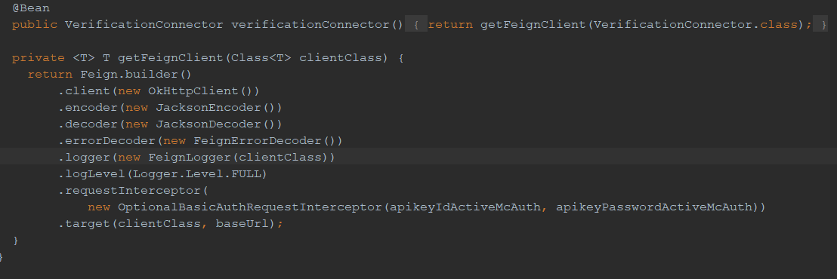
How we use it in Resttest
REST client
SOAP client

Slide 9
Questions?

